Slide 1
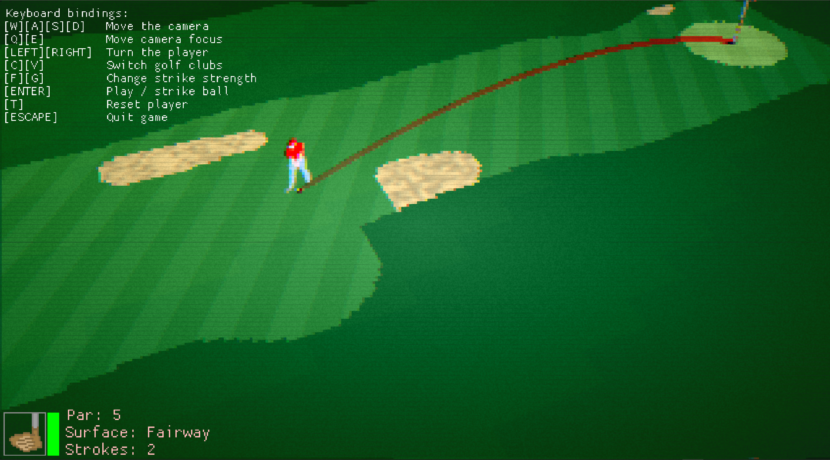
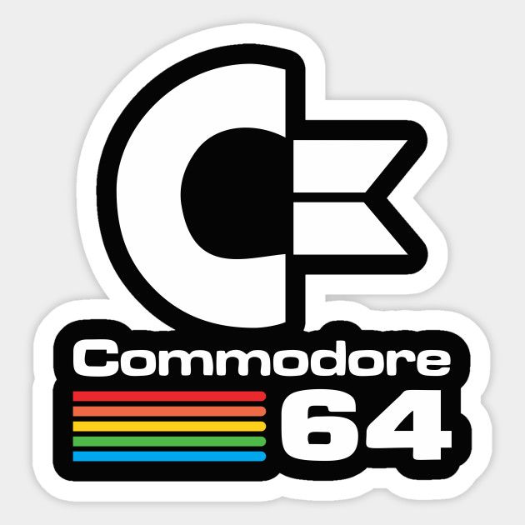
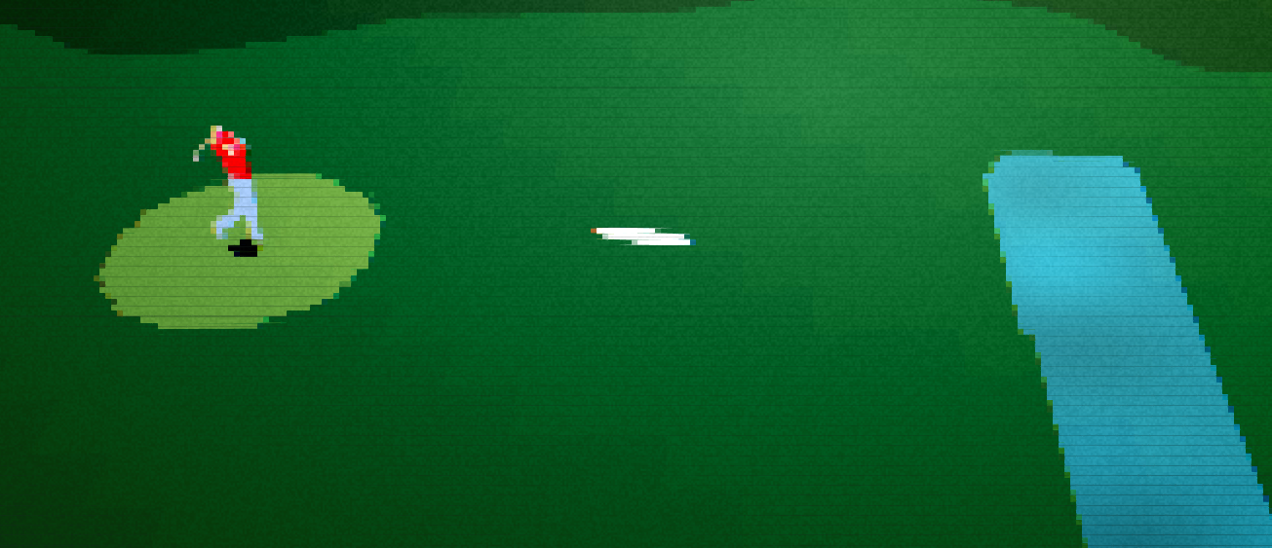

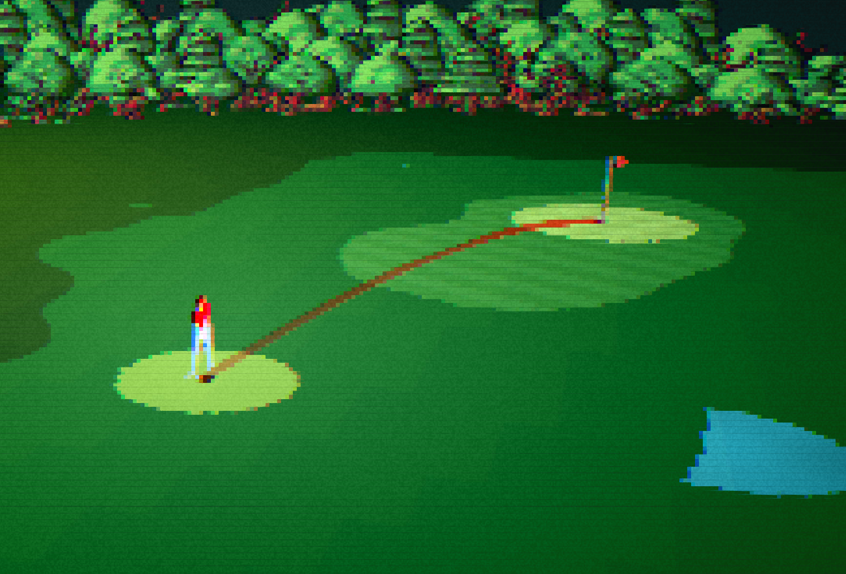
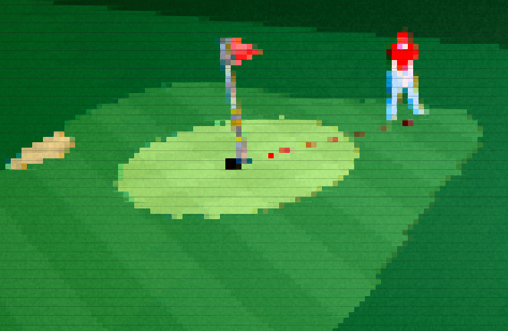
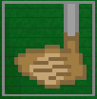
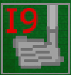
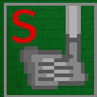
Now with support for the new Commodore64 and 16bit graphics!
Golf God
Golf God
Tiger Woods and Jack Nicklaus were unable to beat this game! Can YOU do it?
Can YOU do it?
MODERN GRAPHICS !
HYPERREALISTIC LANDSCAPES !!!
INFINITE AMOUNT OF GOLF COURSES
Now with 12 different golf clubs!

